Slide 1
Lecture 2
Basic Blueprint Programming Concepts

Slide 2
Lecture Goals and Outcomes
The goals of this lecture are to
Demonstrate how to create variables and modify their properties
Show how to use arithmetic, relational, and logical operators
Present functions, custom events, macros, and their differences
Introduce program flow
By the end of this lecture you will be able to
Create variables using the correct type for each situation
Create expressions using operators
Understand when to use functions, custom events, or macros
Use some basic nodes that control the program flow

Slide 3
Variables

Slide 4
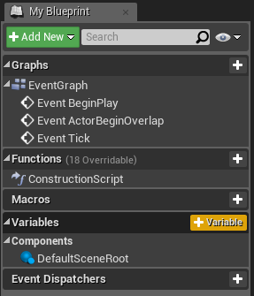
Creating Variables
Variables are used to store values and attributes in Blueprints that can be modified during the execution of the game. The variables can be of different types.
To create a variable, go to the My Blueprint panel in the Blueprint Editor and click the “+” button in the Variables category.

Slide 5
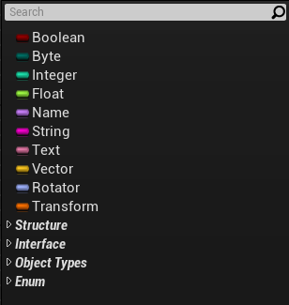
Variable data Types
Following are common types of variables:
Boolean: Can only hold the value “true” or “false”.
Integer: Used to store integer values.
Float: Used to store decimal values.
String / Text: Used to store text. The Text variable is preferable since it supports localization.
Vector: Contains the float values X, Y, and Z.
Transform: Used to store location, rotation, and scale.

Slide 6
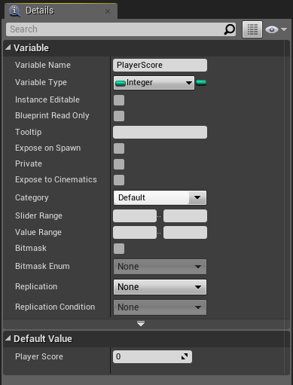
Details panel
When a variable is selected, its properties are displayed in the Details panel. This is where changes can be made to the variable’s name and type.
Other properties found in the Details panel include the following:
Instance Editable: If checked, the variable can be changed in the instances that are in the Level.
Blueprint Read Only: If checked, the variable cannot be changed by Blueprint nodes.
Tooltip: Contains information shown when the cursor hovers over the variable.
Expose on Spawn: If checked, the variable can be set when spawning the Blueprint.

Slide 7
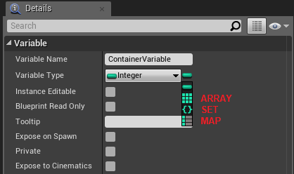
Array, set, and map
The Variable Type property includes a button that is used to convert the variable into a container.
A container can store several elements of the same type. Listed below are the types of containers available.
Array: An ordered list of values that are accessed using an index value.
Set: An unordered collection of values. Duplicate values are not allowed.
Map: A list that uses a key-value pair to define each entry. Duplicate key values are not allowed.

Slide 8
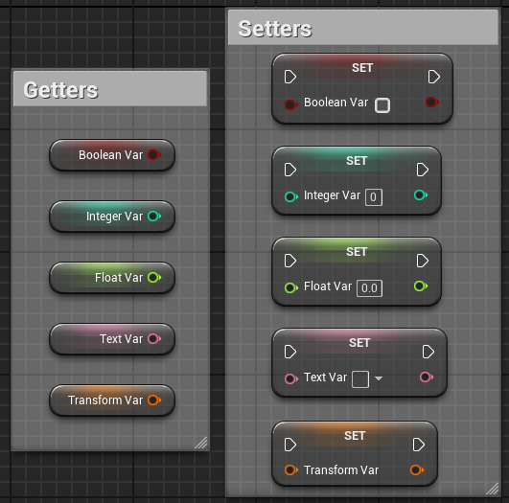
Getters and setters
When a variable is dragged and dropped into the Event Graph, a context menu appears with the options Get and Set.
Get nodes are used to read the value of the variable.
Set nodes are used to store a new value in the variable.
There are useful shortcuts to create Get and Set nodes. To create a Get node, press the Ctrl key when dragging and dropping a variable. The Set node is created using the Alt key.

Slide 9
Operators

Slide 10
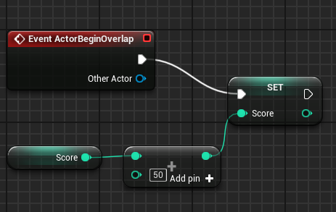
Arithmetic operators
The arithmetic operators ( +, -, *, / ) can be used to create mathematical expressions in Blueprints.
The image on the right shows a simple expression that adds a value of “50” to the current Score variable, then sets the newly calculated value in the Score variable.
The “+” operator receives two input values on the left and gives the operation result on the right. To use more than two input values, just click on the Add pin option.
The input values can be entered directly into the nodes or can be obtained from variables.

Slide 11
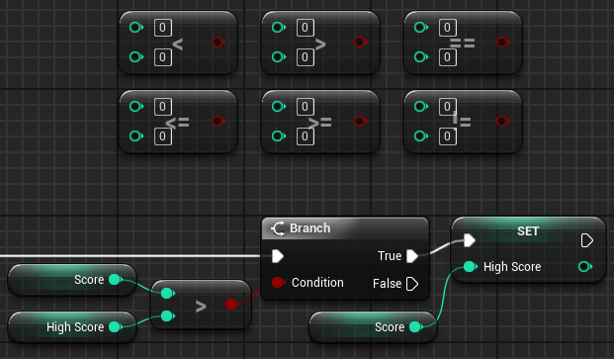
Relational operators
Relational operators perform a comparison between two values and return a Boolean value (“true” or “false”) as a result of the comparison.
The image on the right shows the relational operators and an example using a Branch node. At the end of a game, the current player’s score (Score variable) is compared with the highest recorded game score (High Score variable). If the player’s score is higher, the value of the Score variable will be stored in the High Score variable.

Slide 12
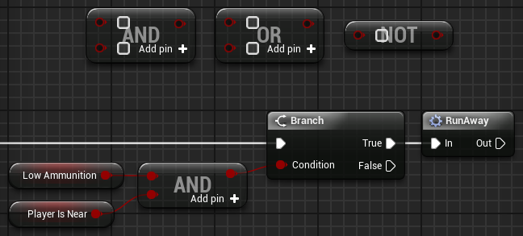
logical operators
Logical operators perform an operation between Boolean values and return a Boolean value (“true” or “false”) as a result of the operation. The main logical operators are as follows:
OR: Returns a value of “true” if any of the input values are “true”.
AND: Returns a value of “true” only if all input values are “true”.
NOT: Receives only one input value, and the result will be the reverse value.
The example on the right simulates a simple decision of an enemy in a game. If the enemy is low on ammo (Low Ammunition variable) and the player is nearby (Player Is Near variable), then the enemy decides to run away.

Slide 13
Functions, events, and macros

Slide 14
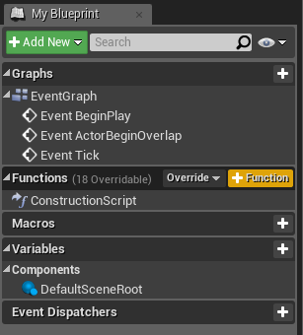
Functions
Functions allow a set of actions that are executed in various parts of the Blueprint to be gathered in one place for easy organization and maintenance of the script.
Functions can be called from other Blueprints and allow the use of input and output parameters.
To create functions, go to the My Blueprint panel in the Blueprint Editor and click the “+” symbol in the Functions category.

Slide 15
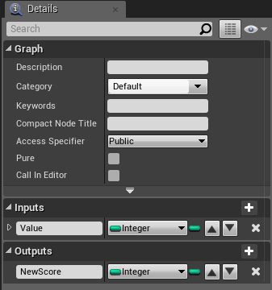
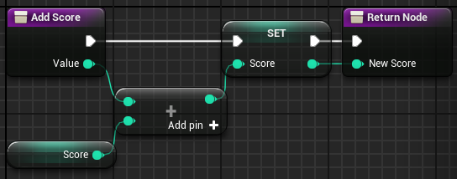
Functions: Inputs and outputs
Input parameters are values that can be passed into a function.
Output parameters are values that can be returned from a function.
To add input or output parameters, select the function in the My Blueprint panel and use the Details panel.
The images on the right show a function with an input parameter named “Value” that is added to the Score variable.
The result of the sum is set in the Score variable, then returned with the output parameter named “New Score”.

Slide 16
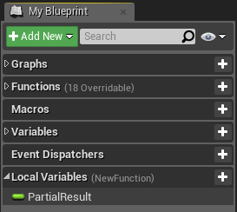
Functions: local variables
Functions allow the use of local variables that are only visible inside the function. They are very effective at assisting in complex functions and do not mix with the other variables of the Blueprint.
To create a local variable, double-click on a function to edit it, then look at the My Blueprint panel. At the bottom of the panel, you will find a category named Local Variables with the name of the function in parentheses. Click the “+” button in the Local Variables category.

Slide 17
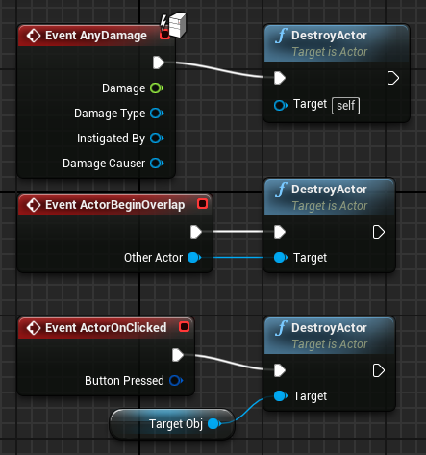
Functions: The Target parameter
The Target parameter is common to several functions and indicates the object that will be modified with the function call.
The default value for this parameter is “self”, which is a special reference to the Actor or Object instance that owns the script being executed.
The image on the right shows different ways to use the Target parameter of the DestroyActor function.

Slide 18
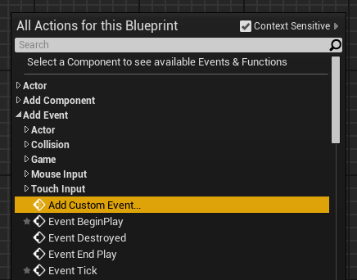
Custom events
Unreal Engine provides a number of predefined events, but it is possible to create new ones to use in a Blueprint. These events can be called from both the Blueprint they are defined in and other Blueprints.
To create a custom event, right-click in the Event Graph, expand the Add Event category, and select “Add Custom Event...”.

Slide 19
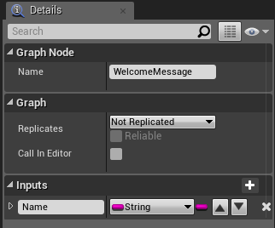
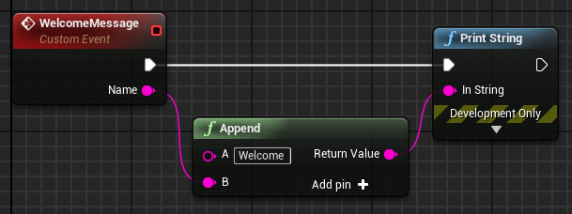
Custom events: input parameters
Selecting a Custom Event node allows you to manage the event name and input parameters. Events do not have output parameters.
The images on the right show a custom event named “WelcomeMessage” with an input parameter called “Name”.
The event will create and print on screen a custom message using the name passed as a parameter.

Slide 20
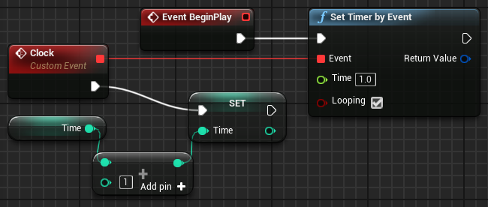
Custom events: delegates
An event has a small red square in the right corner that is known as a delegate. This is just a reference to the event. Some actions receive an event as a parameter, and using the delegate makes that possible.
In the image on the right, the delegate of the custom event named “Clock” is wired to the Set Timer by Event node’s Event input pin, so the Clock event will be called every second.

Slide 21
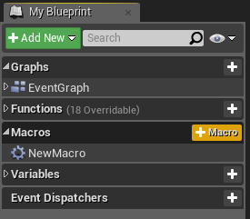
Macros
Another way to gather actions in one common place is to use macros. A macro is similar to a collapsed graph of nodes. At compile time, the actions of a macro are expanded in the places that the macro is being used.
Macros can have input and output parameters, as well as several input and output execution pins.

Slide 22
Macros
vs.
Events vs.
Functions
Macros, custom events, and functions provide different ways to organize script. Each of them has its advantages and limitations. One thing they have in common is that they all have input parameters.
Macros have output parameters and can have many execution paths. They cannot be called from another Blueprint.
Events do not have output parameters. They can be called from other Blueprints and have the “delegate” reference. They support Timelines.
Functions can be called from other Blueprints and have output parameters. Functions do not support latent actions, such as the Delay action.

Slide 23
Program flow

Slide 24
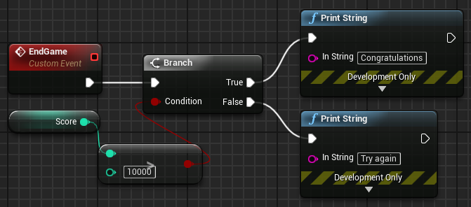
Branch node
The Branch node directs the flow of execution of a Blueprint based on the value of the Boolean input “Condition”, which can be “true” or “false”.
In the image on the right, there is a custom event that is called at the end of the game. The Branch node is used to test if the score is greater than “10000”. A different message will be shown based on the result.

Slide 25
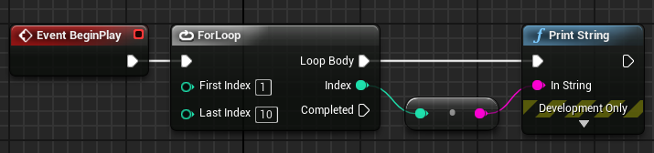
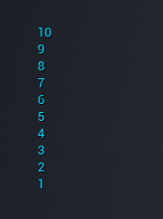
For Loop node
The ForLoop node performs the set of actions that are associated with the output pin Loop Body for each index.
When the ForLoop node completes its execution, the output pin Complete is triggered.
On the right, a ForLoop node is used to execute the Print String node ten times. The value of the Index output pin of the ForLoop node is used as the input for the Print String node.
The conversion node is automatically created by the Editor when an integer value is connected to a string input.

Slide 26
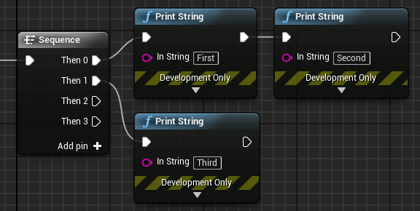
Sequence node
A Sequence node can be used to help organize other Blueprint actions. When triggered, it executes all the nodes connected to the output pins in sequential order—that is, it executes all the actions of pin Then 0, then all the actions of pin Then 1, and so on.
Output pins can be added using the Add pin + option. To remove a pin, right-click on the pin and choose the Remove execution pin option.

Slide 27
SUMMARY
This lecture showed how to create variables and how to use operators to create expressions.
Functions, custom events, and macros were presented, and the lecture introduced some basic nodes that control the program flow.

